Slide 1

Slide 1
Telangana’s Growth Analysis
Telangana's economy has been on a growth trajectory since its formation. Is one of the state with an open data policy. The state is known for its information technology (IT),
The state government has introduced policies to attract investments and promote industrial development

Slide 2
Slide 1
Objective:
• Explore Stamp Registration, Transportation and Ts-Ipass Datasets. Understand their attributes, categories and time period. • Analyze trends and patterns within each department. • Identify growth opportunities and areas needing attention. • Find correlation among these departments and report the overall growth of the state through insights and relevant visuals such as shape maps.

Slide 3
Slide 10
1. Rangareddy
2. Medchal Malkajgiri
3. Hyderabad
4. Sangareddy
5. Hanumakonda This Top 5 Districts shown highest Growth in document registration revenue from FY 19-22. It suggests that the districts are experiencing economic vitality, attracting investments, and fostering a conducive environment for business.
Stamp Registration
How does the revenue generated from document registration vary across districts in Telangana? List down the top 5 districts that showed the highest document registration revenue growth between FY 2019 and 2022.

Slide 4

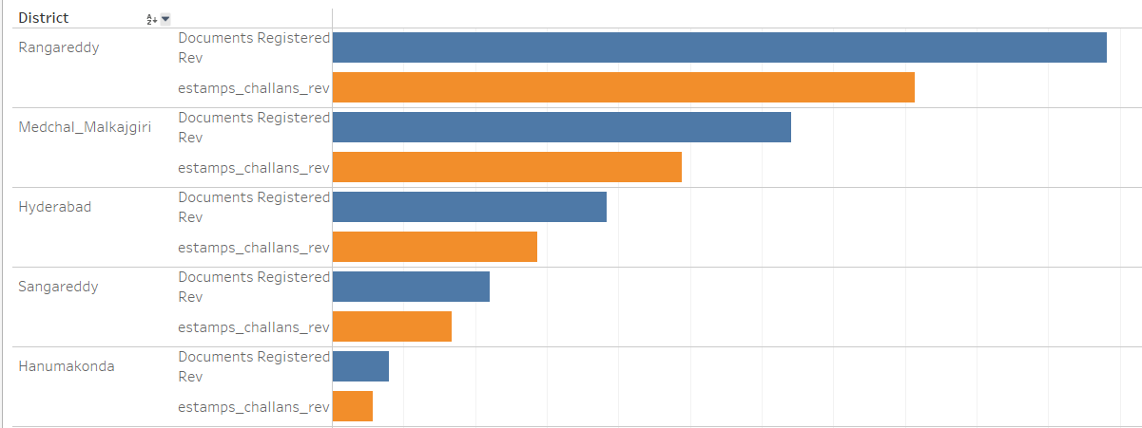
Slide 10
Top 5districts where e-stamps revenue contributes significantly more to the revenue than the documents registration in FY 2022. Mostly because Urbanization and Population Density, Economic Activity , Digital Literacy. Literacy.
Stamp Registration
How does the revenue generated from document registration compare to the revenue generated from e-stamp challans across districts? List down the top 5 districts where e-stamps revenue contributes significantly more to the revenue than the documents in FY 2022?

Slide 5

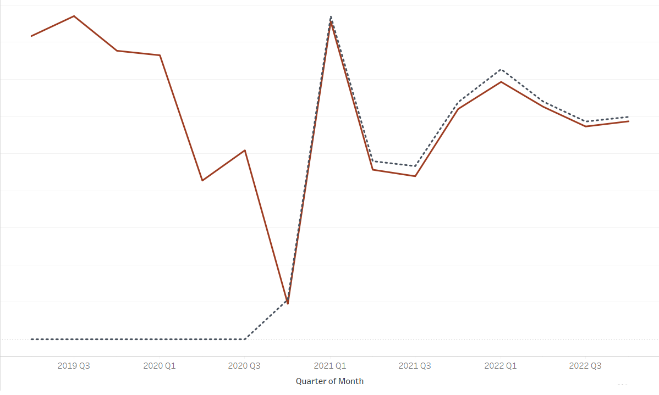
Slide 10
Since the implementation of E-Stamp challan in year 2020, it has been steadily growing alongside traditional document registration methods. The trend indicates that E-Stamp challan usage is slightly higher, suggesting people are embracing it
Stamp Registration
Is there any alteration of e-Stamp challan count and document registration count pattern since the implementation of e-Stamp challan? If so, what suggestions would you propose to the government?

Slide 6
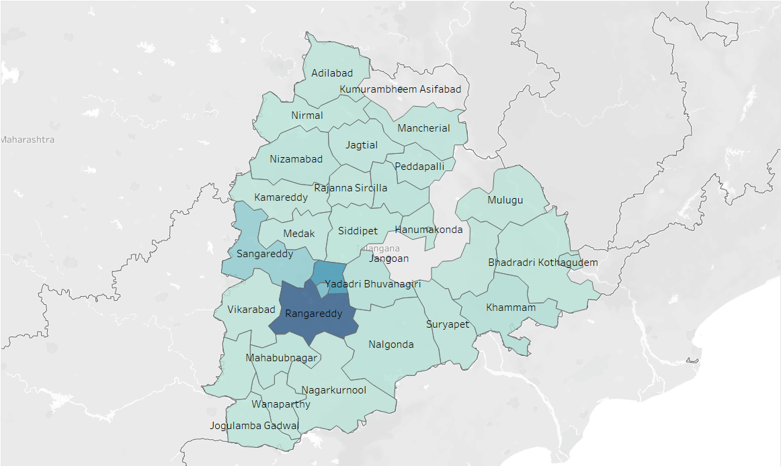
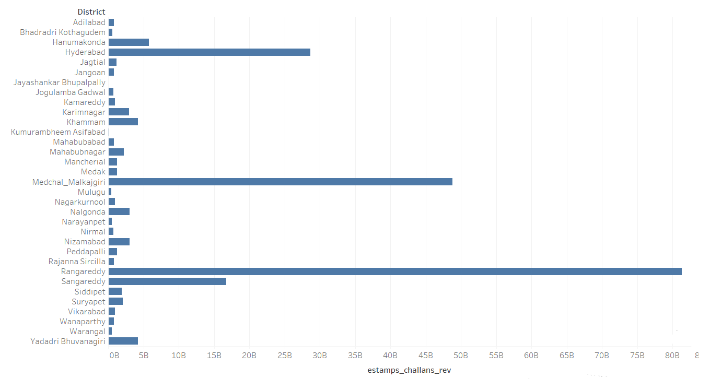
Slide 10
T Rangareddy, Medchal Malkajgiri, Hyderabad are top 3 district with Highest registration revenue Kumurambheem Asifabad, Mulugu , Warangal are district with lowest registration revenue
Stamp Registration
Categorize districts into three segments based on their stamp registration revenue generation during the fiscal year 2021 to 2022

Slide 7
Slide 9
Suggestions
Awareness Campaigns
Demonstrate Savings
Awareness campaign about the benefits of e-stamps, focusing on cost savings, convenience, and security.
Show users the potential cost savings by using E-stamps compared to traditional paper stamps. Provide a cost calculator tool to estimate savings on stamp duties
E- stamp use minimizes the risks associated with paper-based stamping and contributes to a more secure and transparent financial and legal environment
User Support
Establish a dedicated customer support team to assist users with any issues or questions related to e-stamps.

Slide 8
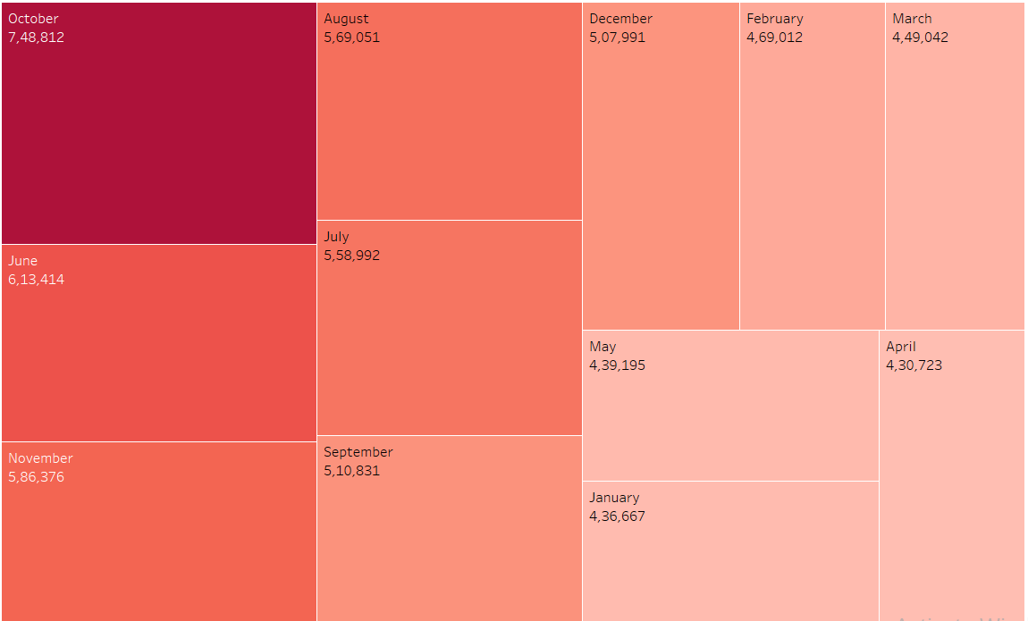
Slide 10
In the context of fuel types, it's noteworthy that the month of October had the highest purchase rate, which translates to a significant 748 K units sales. This is mainly because The festival of Diwali. End of the financial year in March can see higher purchase purchases as individuals and businesses rush to make purchases to avail of tax benefits.
Transportation
Investigate whether there is any correlation between vehicle sales and specific months or seasons in different districts. Are there any months or seasons that consistently show higher or lower sales rate, and if yes, what could be the driving factors? (Consider Fuel-Type category only

Slide 9
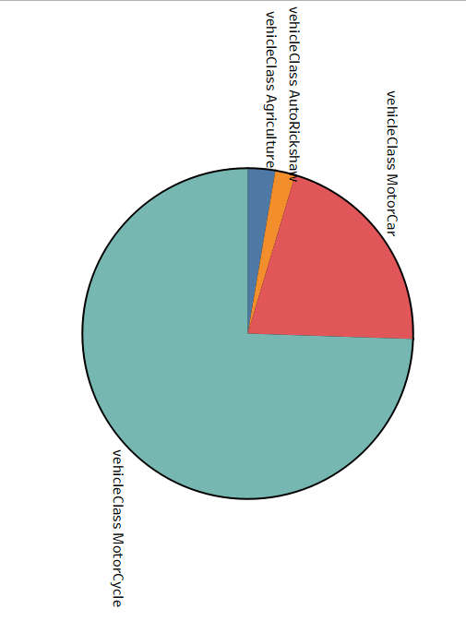
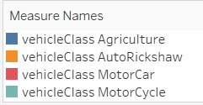
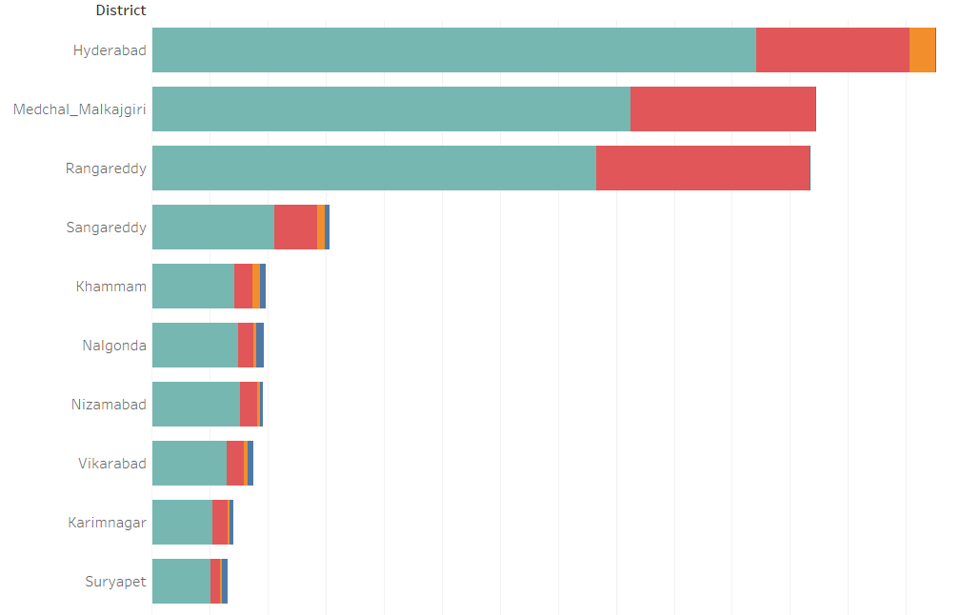
Slide 10
Distribution of vehicle class: for FY 2022 Notably, motorcycles constituted the majority of the total vehicle sales followed by motorcar
Transportation
How does the distribution of vehicles vary by vehicle class (MotorCycle, MotorCar, AutoRickshaw, Agriculture) across different districts? Are there any districts with a predominant preference for a specific vehicle class? Consider FY 2022 for analysis.

Slide 10
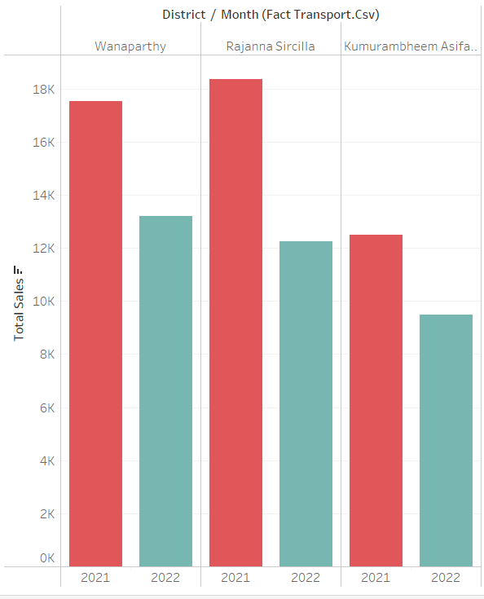
Slide 10
Hyderabad, Medchal malkajgiri, Rangareddy are top 3 and Wanaparthy, Rajanna Sricilla, Asifabad are bottom3 districts that have shown the highest and lowest vehicle sales growth during FY 2022 compared to FY 2021
Transportation
List down the top 3 and bottom 3 districts that have shown the highest and lowest vehicle sales growth during FY 2022 compared to FY 2021? (Consider and compare categories: Petrol, Diesel and Electric).
Top 3
Bottom 3

Slide 11
Slide 10
Plastic and Rubber, Pharmaceuticals & Chemicals, Real Estate- Industrial, Solar – Other renewable energy & Engineering are the top 5 sectors that have witnessed the most significant investments in FY 2022.
Ts-Ipass
List down the top 5 sectors that have witnessed the most significant investments in FY 2022

Slide 12
Slide 10
From FY 2019 to 2022 top 3 districts that attracted most significant sector investments are Rangareddy, Sangareddy & Medchal Malkajgiri One of the main factor is Proximity to Hyderabad the state capital and a major economic hub Proximity to transportation hubs such as airports and railway stations facilitates the movement of goods and people, making them logistics and distribution hotspots Proactive government policies, incentives, and initiatives to promote industrial growth and investment
Ts-Ipass
List down the top 3 districts that have attracted the most significant sector investments during FY 2019 to 2022? What factors could have led to the substantial investments in these particular districts?

Slide 13
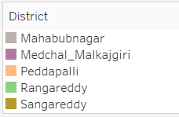
Slide 10
Here are some particular sectors that have shown substantial investment in multiple districts between FY 2021 and 2022 in Telangana: Pharmaceuticals and Chemicals: This sector has attracted significant investment in districts such as Rangareddy, Medchal-Malkajgiri, Sangareddy. Plastic and Rubber: This sector has also attracted significant investment in districts such as Rangareddy, Medchal-Malkajgiri, Sangareddy and Hyderabad. Real Estate Industrial: Notably this sector has primarily attracted investment in Rangareddy district indicating a concentration of real estate and IT development in that area
Ts-Ipass
Are there any particular sectors that have shown substantial investment in multiple districts between FY 2021 and 2022?

Slide 14
Slide 10
Overall sector investment MAY records the lowest sector investment at 1,842.50 CR while AUGUST stands out the highest investment at 5,102 CR. This suggests a potential trend of higher investment during summer months
Ts-Ipass
Can we identify any seasonal patterns or cyclicality in the investment trends for specific sectors? Do certain sectors experience higher investments during particular months?

Slide 15
Slide 5
Key Insights
Since the implementation of the e-stamp challan system, the government has not only streamlined revenue collection but has also witnessed a substantial increase in revenue generation. This reflects not only the efficiency of the system but also the potential for further financial growth.
The top six sectors - Real Estate, Industrial Parks and IT Buildings, Pharmaceuticals and Chemicals, Engineering, Food Processing, Plastic and Rubber and R&D—have not only exhibited remarkable growth but also offer a wealth of promising job opportunities. Their expansion not only fuels economic development but also fosters extensive employment prospects, underlining their pivotal role in shaping a prosperous future.
Among the total vehicle sales, a significant 93% comprise brand new vehicles, indicating a strong preference for new and freshly manufactured automobiles in the market

Slide 16
Slide 9
Recommendation
To maximize the e-stamp challan system's growth potential, recommend offering incentives, extensive awareness campaigns, and step-by-step guides. Implement a robust tracking application and introduce a chat bot for FAQs to provide quick and user-friendly assistance, fostering wider adoption.
Create a business-friendly regulatory environment with streamlined processes for permits, licenses, and approvals.
In response to the surging electric vehicle (EV) sales, it is imperative to proactively implement a robust network of charging stations and develop the necessary infrastructure to meet the escalating demand for electric vehicles. This strategic infrastructure investment is essential to ensure the seamless integration and widespread adoption of EVs, fostering a sustainable and eco-friendly transportation ecosystem.
Prioritize STEM education to meet the demands of evolving industries, and promote digital literacy to bridge the digital skills gap

Slide 17
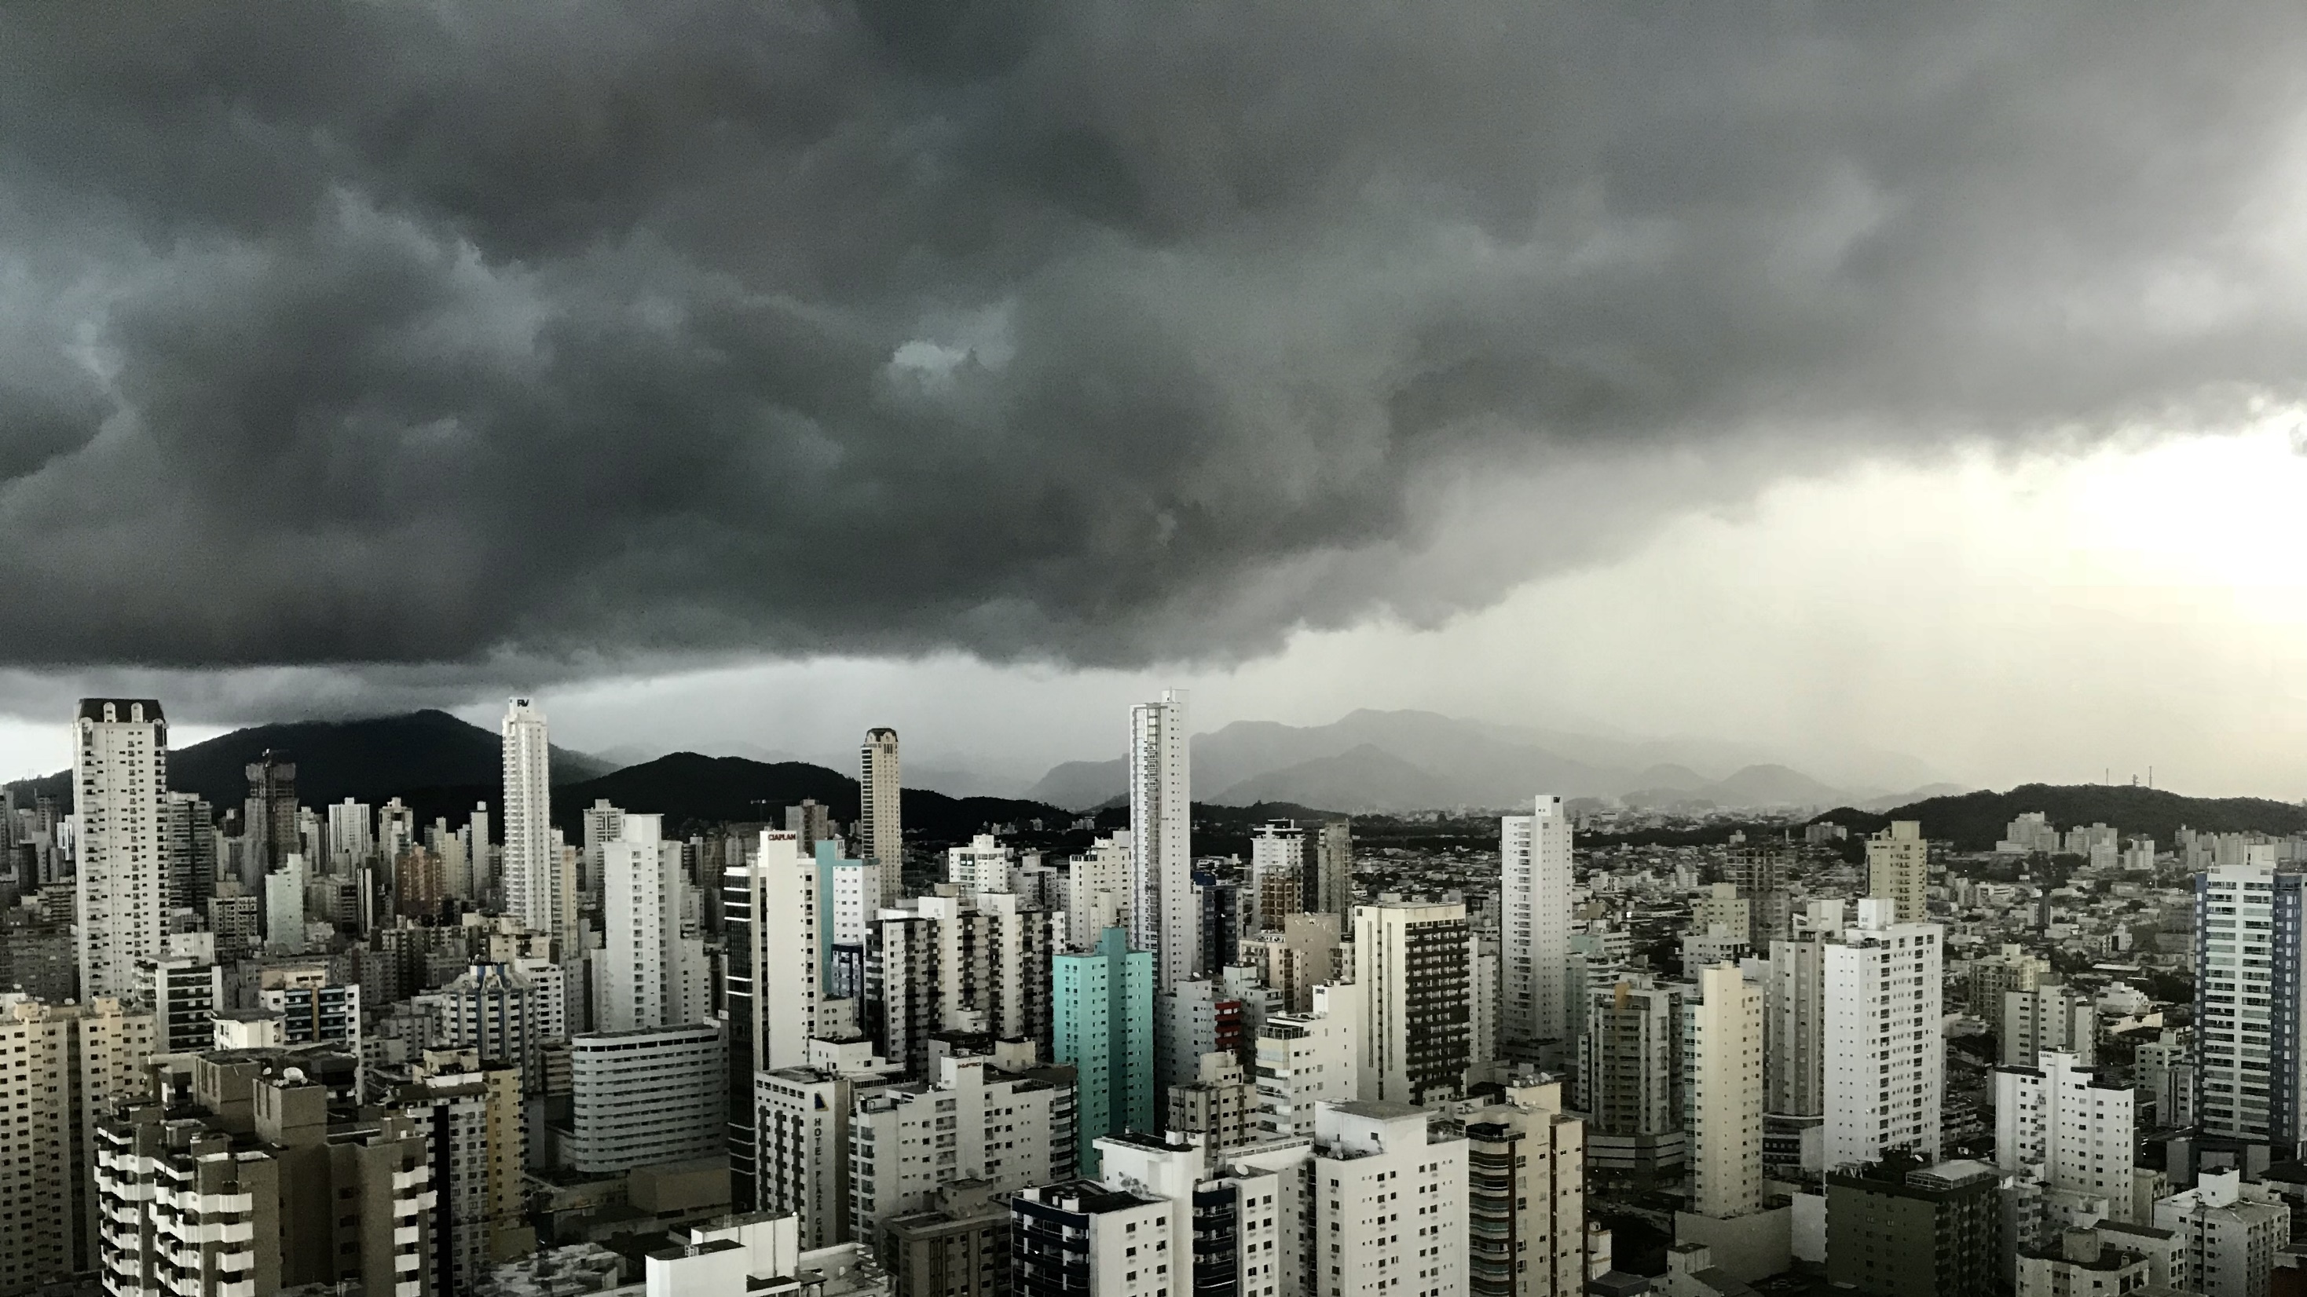
Slide 11
THANK YOU
. Tarun Raj . Tarunraj453@gmail.com

